Slide 1


Respiratory Rate Estimation Using Pressure Sensor Mattresses
Artemisia Sarteschi
Prof. Riener (ETHz)
Prof. Sorrenti (UniMiB)
Zürich, 23 February 2023

Slide 2



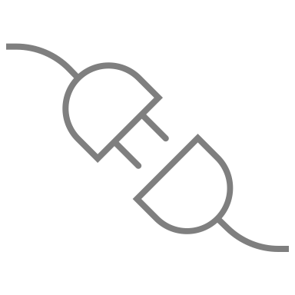

Overview
Introduction
Methods
Data Analysis
Result
Conclusion

Slide 3
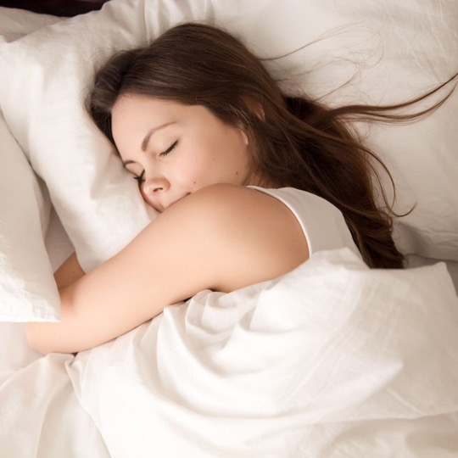
Introduction: Why?
Sleep stages^{[1][2]}
Non-Rapid Eye Movement (NREM)
The breathing rate decelerates
The respiratory pattern becomes more regular
Rapid Eye Movement (REM)
The breathing rate accelerates
The respiratory pattern becomes irregular
[1] Tataraidze A et al. « Sleep stage classification based on respiratory signal »
[1] Tataraidze A et al. « Sleep stage classification based on respiratory signal »
[2] H. -t. Wu et al. « Assess Sleep Stage by Modern Signal Processing Techniques »
Notes:
The longest moment when a person is lying down on a mattress is during the night, so estimate the respiratory rate can help to distinguisce this two moment but also help with all the other moment when is necessary to know what is goingo on

Slide 4
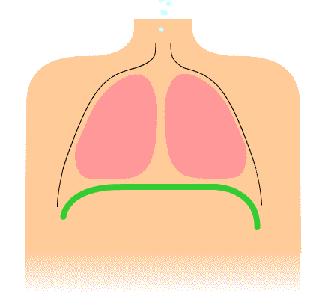
Introduction: Definition of a Breath^{[1][2]}
Respiration is the physiological process of our body to exchange carbon dioxide with oxygen
Inhalation mainly happens through actively contracting the diaphragm and increasing the thoracic cavity
Exhalation typically occurs as a passive process due to the elasticity of the lungs
[1] Chourpiliadis C. et al. « Respiratory Rate » [2] Lutfi et al. « The physiological basis and clinical significance of lung volume measurements »

Slide 5
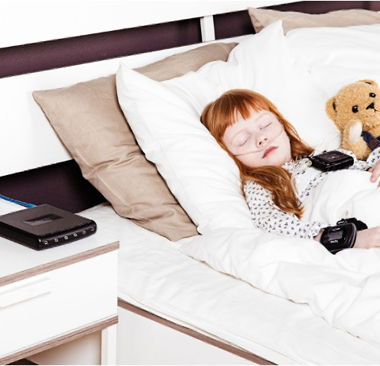
Introduction: Our Gold Standard
Cardiorespiratory polysomnography^{[1]}:
Invasive
Nose Canula
Chest Belts
The device must be placed on the chest
If not worn correctly can lead to false measurements
[1] J.M. Calleja et al. « Comparison of a cardiorespiratory device versus polysomnography for diagnosis of sleep apnoea »

Slide 6
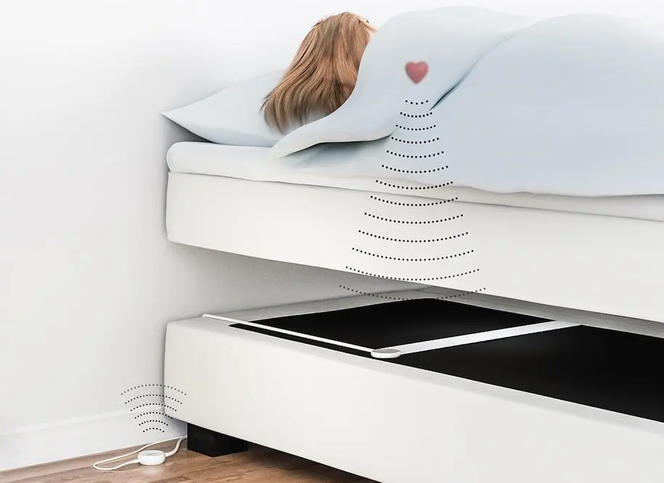
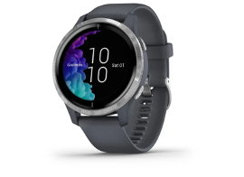
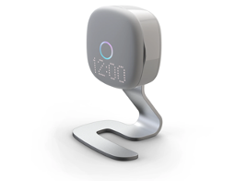
Introduction: Unobtrusive Approach
Under mattress sensor (Emfit^{[1]})
Smartwatch (Garmin^{[2]})
Radar (Somnofy^{[3]})
Unobtrusive devices available on the market
Emfit: under mattress ballistocardiography based sensor^{[4]}
Garmin: wearable monitor device^{[5]}
Somnofy: contactless sleep monitor based on radar technology^{[6]}
[1] https://emfit.com [2] https://www.garmin.com. [3] https://somnofy.com
[4] Esa Rauhala et al. «Compressed tracheal sound analysis in screening of sleep-disordered breathing»
[5] Chinoy ED et al. «Performance of seven consumer sleep-tracking devices compared with polysomnography» [6] Ståle Toften et al. «A Pilot Study of Detecting Individual Sleep Apnea Events Using Noncontact Radar Technology, Pulse Oximetry, and Machine Learning»
Notes:
Key Point of this slide (AS): there are many possible approaches to tracking breath rate available on the market:
Emfit: this is a band that should be positioned under the mattress, or half of the bed if it is shared between two people, and the incorrect position could lead to incorrect prediction.
Gargim: implies having a swatch when during sleep that can lead to discomfort
Somnofy: the radar technology is not reliable when there are more people in one room
our requirement, somnomat: the possibility to integrate the SensingTex with somnomat and track the health of the patient while there are interventions for apnea
Inserire I link

Slide 7
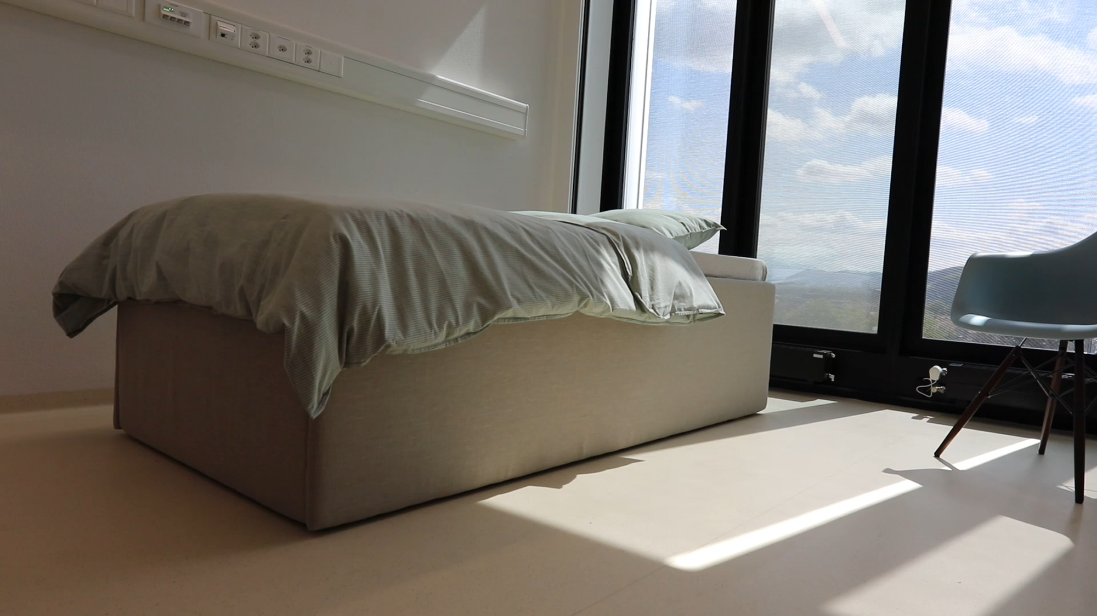
Introduction: Requirements
Somnomat
Find an instrument that can be integrated with Somnomat
Use no invasive approach
Access to raw data for more accurate and immediate interventions
Rocking Bed (Somnomat)
Notes:
Og: The professor really care about the requirementS slide so pay attention at it. First bullet point can be change to sound more scientific in the following way: “find an instrument that can be integrated with Somnomat”.
Second bullet point also can be more scientific ”use no invasive approach”.
You can consider to put a slide in the conclusion where you say that you have met those requirements.
We didn’t play the intervention, but you could use the mat with the moving bed without interference, accessing the raw data and with a contactless unobtrusive device.

Slide 8
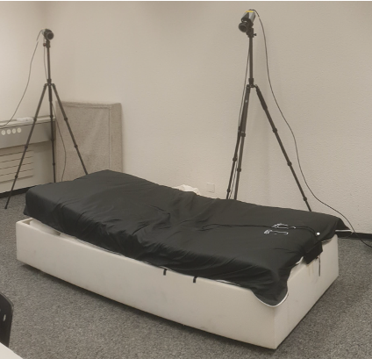
Introduction: Our instrument
Pressure sensor mattress^{[1]} (SensingTex^{[2]}):
An unobtrusive sensor placed over the normal mattress
Not influence the natural sleep of the person
Not lead to privacy concerns
SensingTex
SensingTex over a bed
[1] N. Vyas et al. « Sleep Stage Classification Using Non-Invasive Bed Sensing and Deep Learning »
[2] https://sensingtex.com/sensing-mats/mattress-mat/

Slide 9
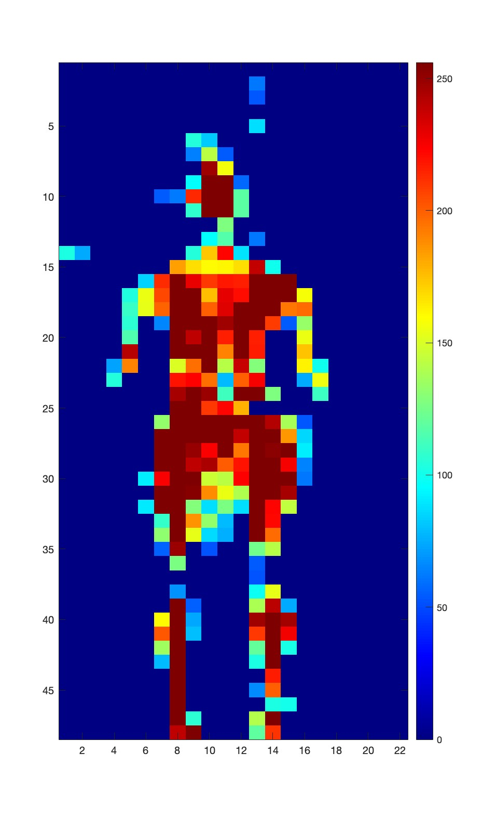
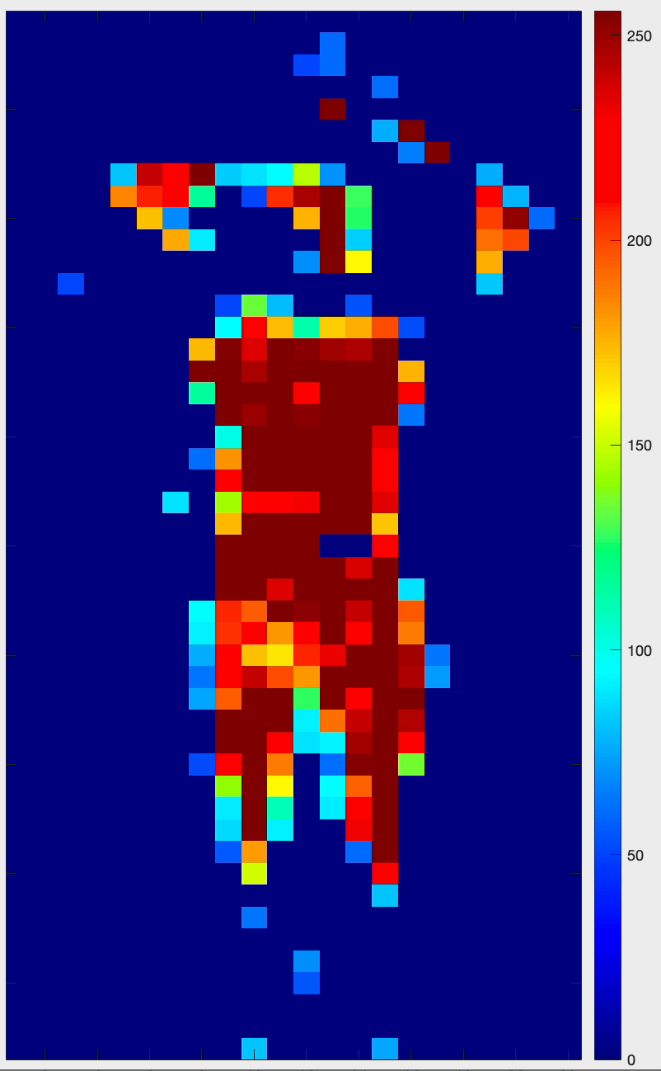
Introduction: SensingTex
22 sensors (94 cm)
48 sensors
(192 cm)
Sensor Area Density ≈ 4 sensors per 10 cm²
Pressure on the SensingTex

Slide 10
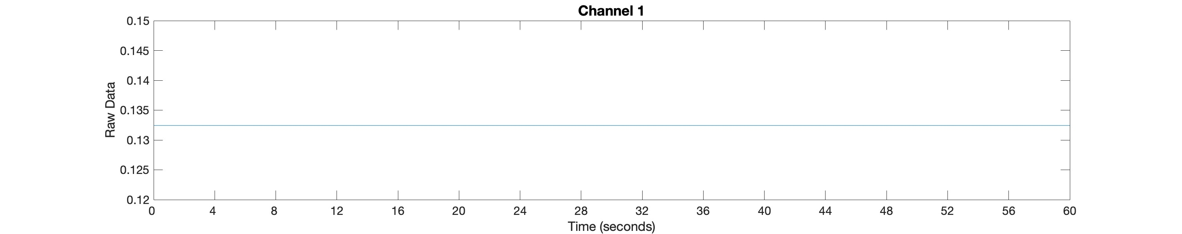
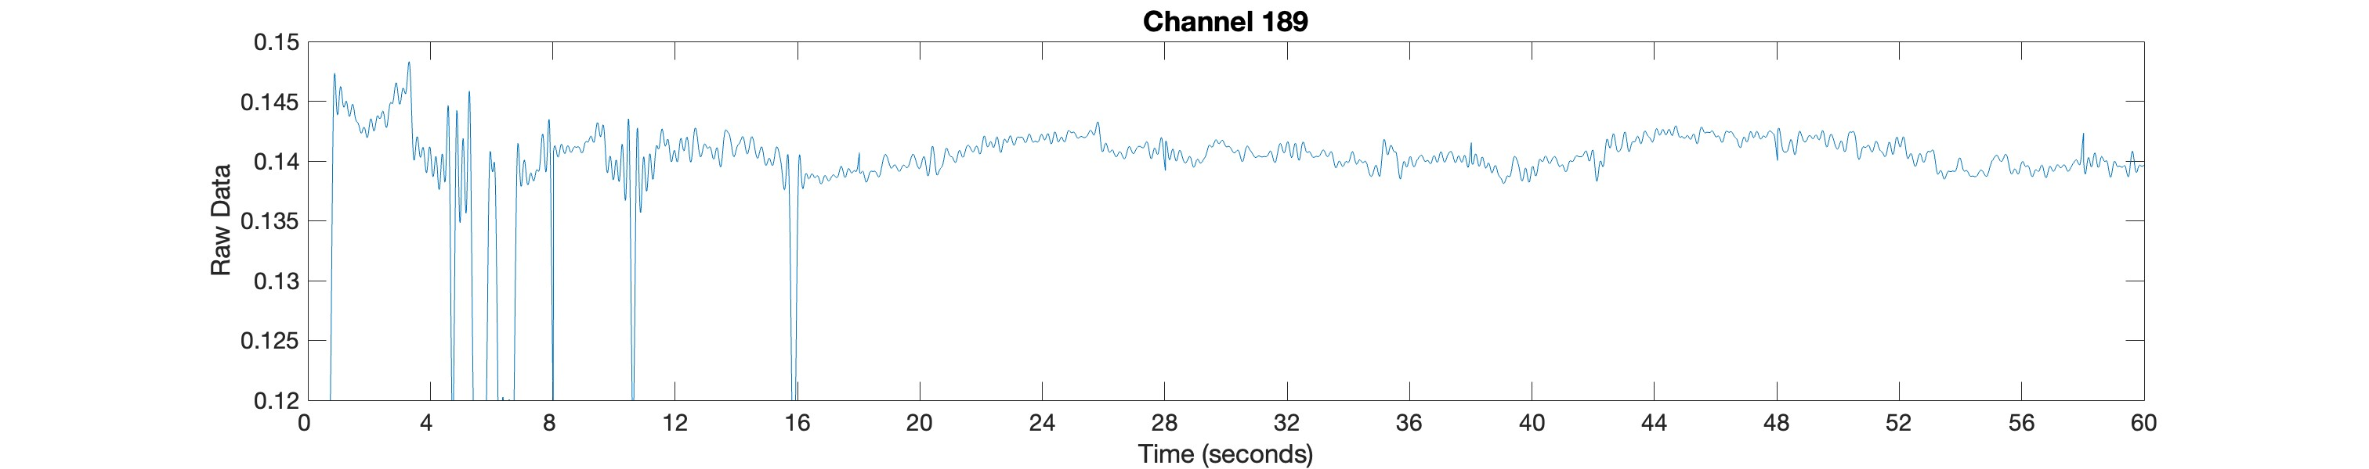
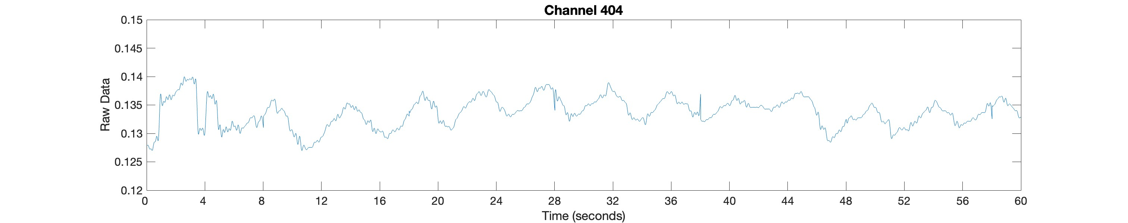
Introduction: Signal from the mattress
Pressure on the SensingTex
Liu, J. J. et al. « BreathSens: A Continuous On-Bed Respiratory Monitoring System With Torso Localization Using an Unobtrusive Pressure Sensing Array »

Slide 11
Introduction
Our Goal
Estimate the respiratory rate from the mattress
The Mean Average Percentage Error (MAPE) should not exceed 20%^{[1]}
Find the best channels where to measure the respiratory rate
Define confidence metrics to identify the best channels
Understand if the mattress can be integrated with the Somnomat
Possibility to use the mattress without interference from the moving of the bed
[1] Sadek I. et al. «A New Approach for Detecting Sleep Apnea Using a Contactless Bed Sensor: Comparison Study»

Slide 12


Overview
Introduction
Methods
Data Analysis
Result
Conclusion

Slide 13
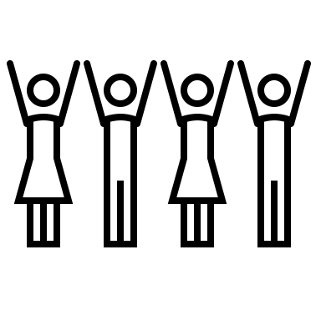



Data collection
Population:
6 volunteers
20-30 years
3 females / 3 males
Phase:
Stationary Bed
Rocking Bed (Somnomat)
Setting for Somnomat:
Period for the movement of the bed is 4 seconds (15 periods in a minute) with an acceleration of 0.25 m/s²
Time:
The total time per participant is 35 minutes
Notes:
Key point AS: Aim of the Data Collection -> Collect different breath rate to give variability to data & Collect data in a controlled environment

Slide 14
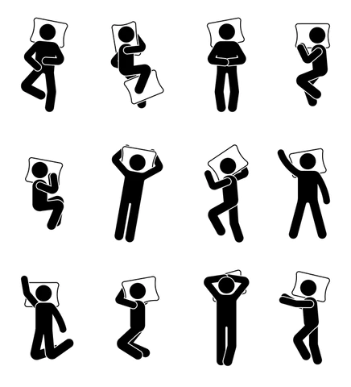

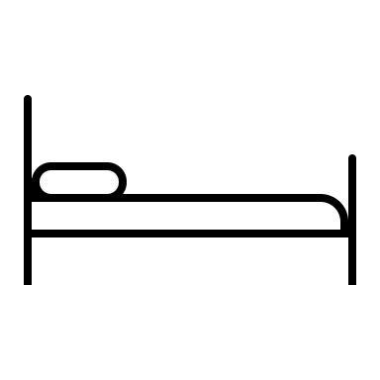
Data collection: Stationary bed
4 minutes lying down on the mattress
Right side
Prone
Supine
Left side
Notes:
Insert variability in the data
Study the behaviour of the pressure mattress in a ideal condition

Slide 15
Data collection: Somnomat
4 minutes lying down on the mattress
Left side
Right side
Supine
Prone

Slide 16
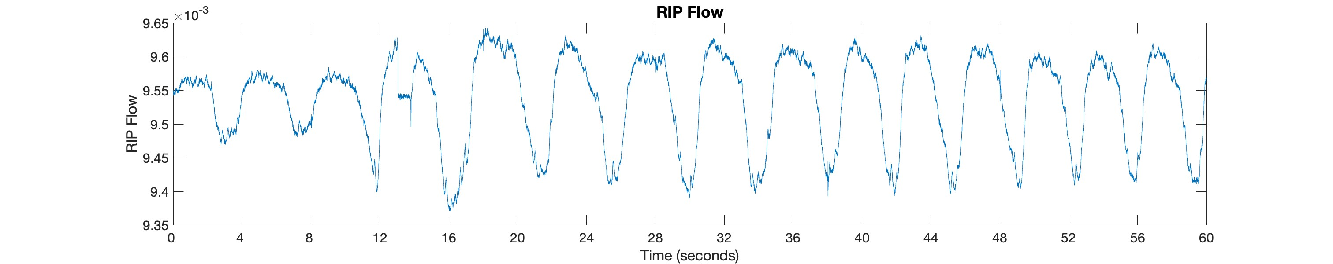
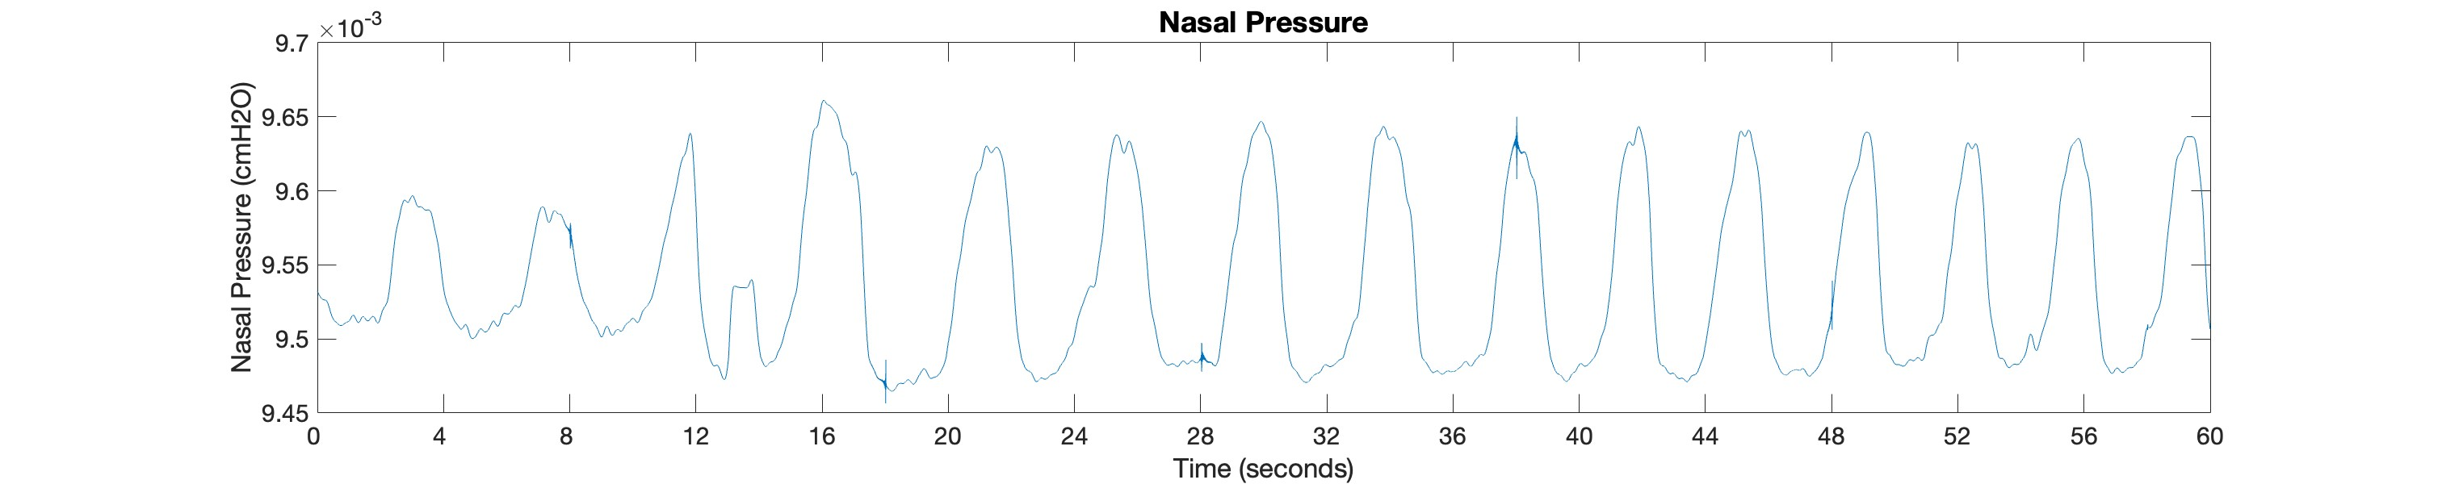

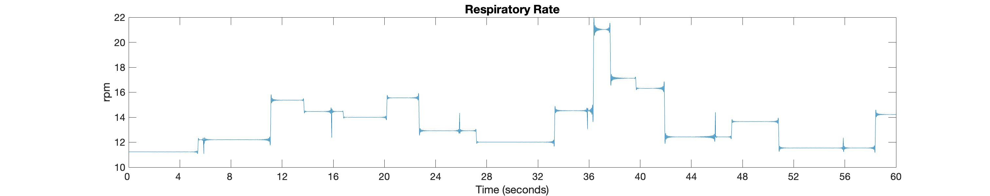
Data collection: Ground Truth
Noxturnal App^{[1]}
Data extracted from the Cardiopulmonary Polysomnography
[1] https://noxmedical.com/products/

Slide 17

Overview
Introduction
Methods
Data Analysis
Result
Conclusion

Slide 18
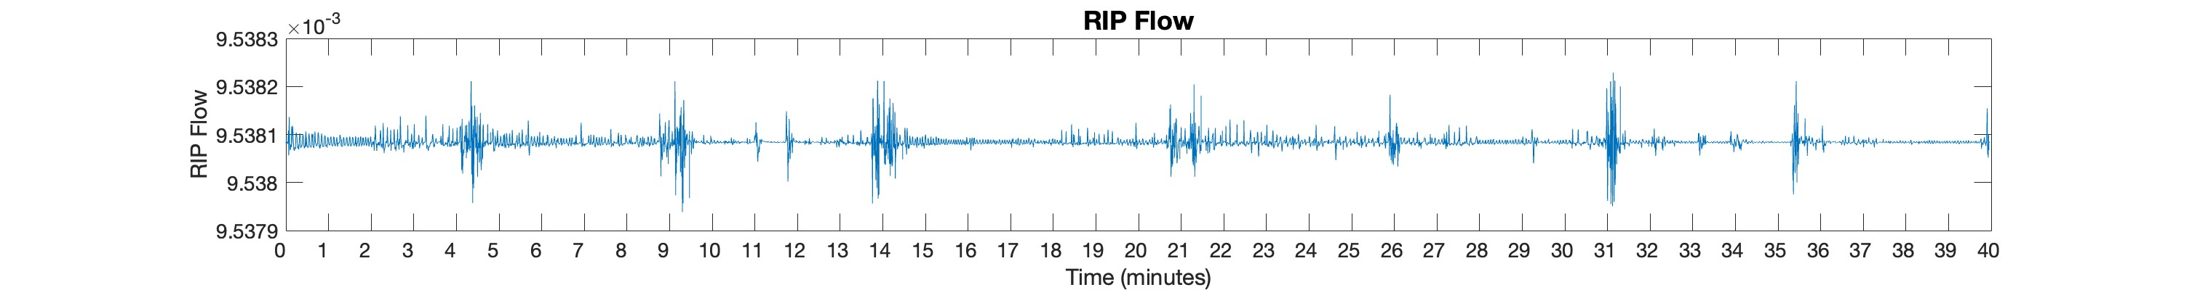
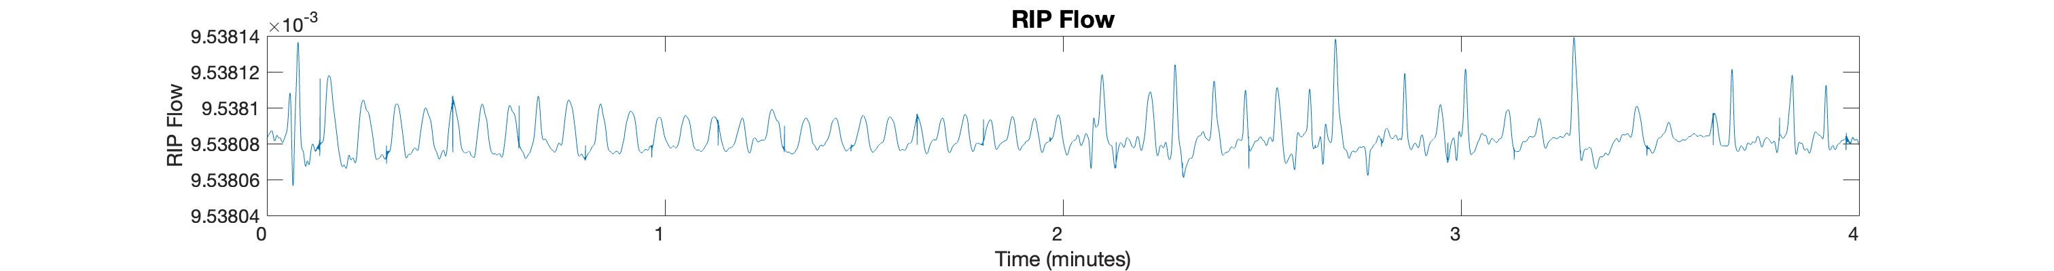
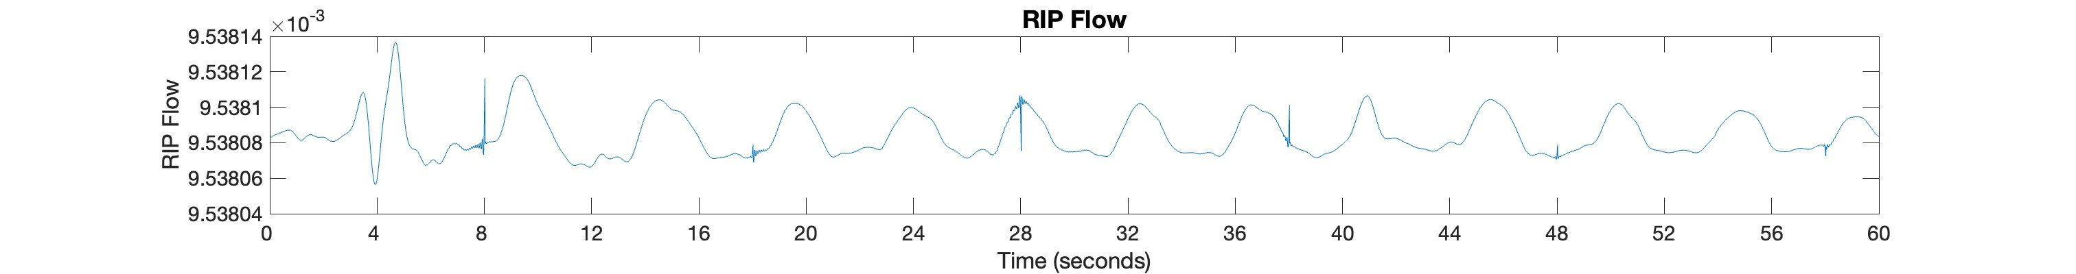
Data Analysis: Pre-processing of the data
Full recording
4 minutes
Prone
Left Side
Supine
Right Side
Prone
Left Side
Supine
Right Side
Stationary Bed
Moving Bed
1 minute

Slide 19
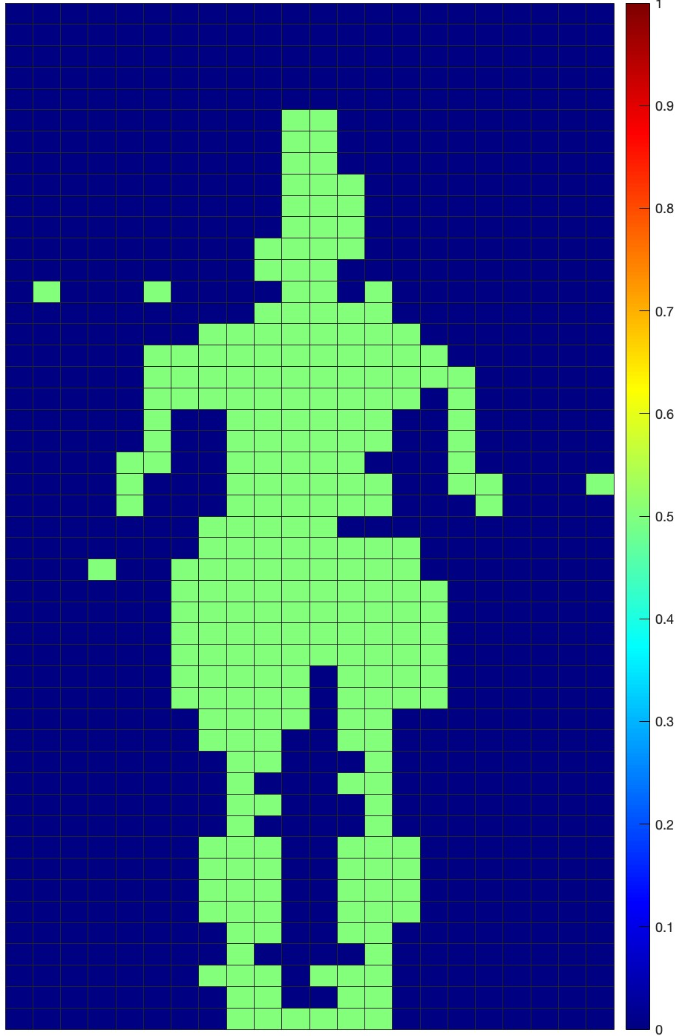
Data Analysis: Confidence Metrics
Insert criteria to exclude channel
Metrics that give a percentage of confidence to assert that are good channels to estimate a breath rate
Use the mean of the estimated number of breaths per minute coming from the best channels (confidence over 90%) to calculate our respiratory rate per minute
Active channels in the mattress
Notes:
OG: “find” instead of “discover”. ✅
Would be nice to show it also with graphs
Key point AS: the idea in this slide is to show the preliminary steps to asset which one could be not be considered as possible channel, we have 1056 and we are looking for the best ones so even exclude the one with just a small amount of information is not relevant
fare più slide e dividerle, riscrivere gli assi e metterli consistenti
inserie un refernce per l'intervallo 30%
- stationary rather than zero
- confidence typo there in amplitude

Slide 20
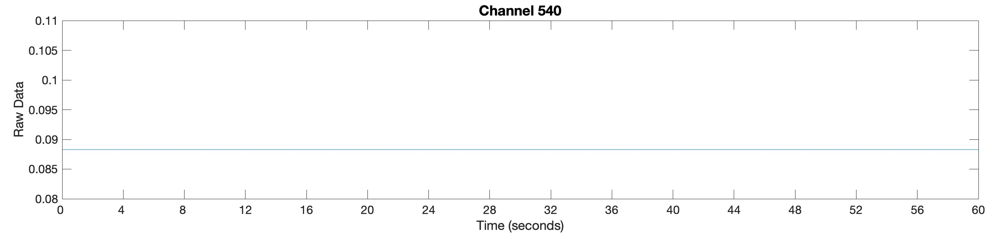
Data Analysis: Confidence Metrics
Exclude all the channels with stationary signals
Notes:
OG: “find” instead of “discover”. ✅
Would be nice to show it also with graphs
Key point AS: the idea in this slide is to show the preliminary steps to asset which one could be not be considered as possible channel, we have 1056 and we are looking for the best ones so even exclude the one with just a small amount of information is not relevant
fare più slide e dividerle, riscrivere gli assi e metterli consistenti
inserie un refernce per l'intervallo 30%
- stationary rather than zero
- confidence typo there in amplitude

Slide 21
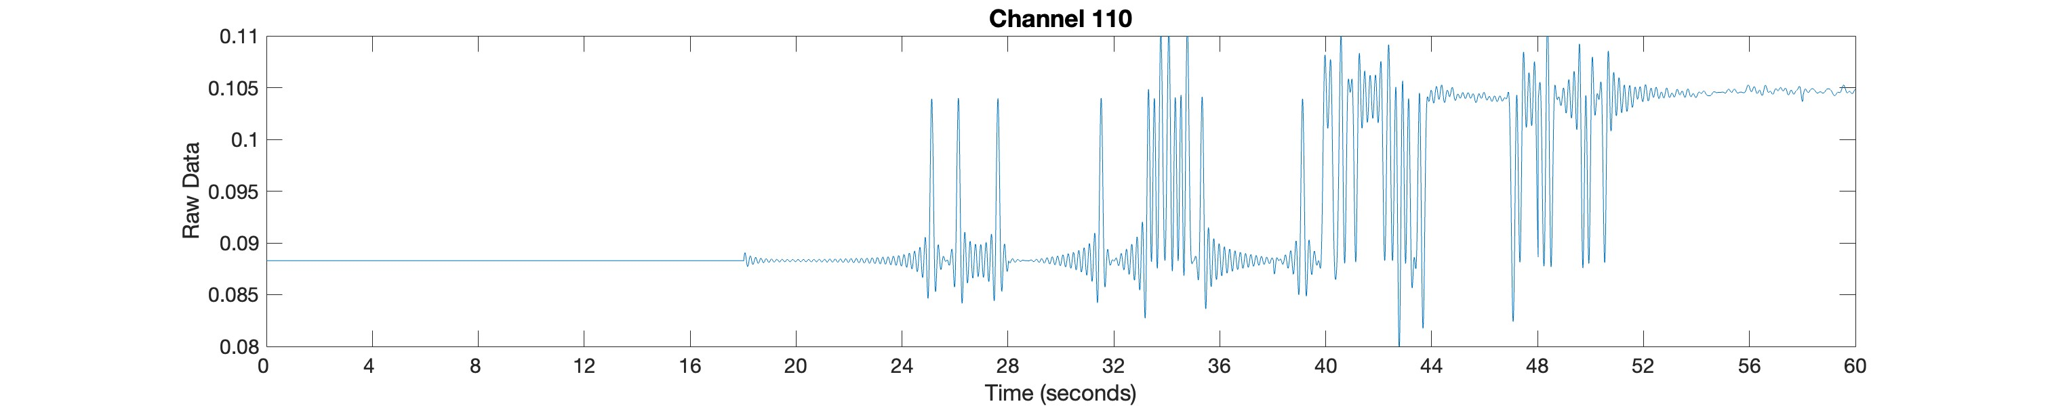
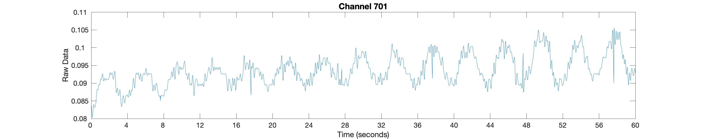
Data Analysis: Confidence Metrics
Exclude all channels with more than 30% spikes (artefacts from the mattress)
Notes:
OG: “find” instead of “discover”. ✅
Would be nice to show it also with graphs
Key point AS: the idea in this slide is to show the preliminary steps to asset which one could be not be considered as possible channel, we have 1056 and we are looking for the best ones so even exclude the one with just a small amount of information is not relevant
fare più slide e dividerle, riscrivere gli assi e metterli consistenti
inserie un refernce per l'intervallo 30%
- stationary rather than zero
- confidence typo there in amplitude

Slide 22
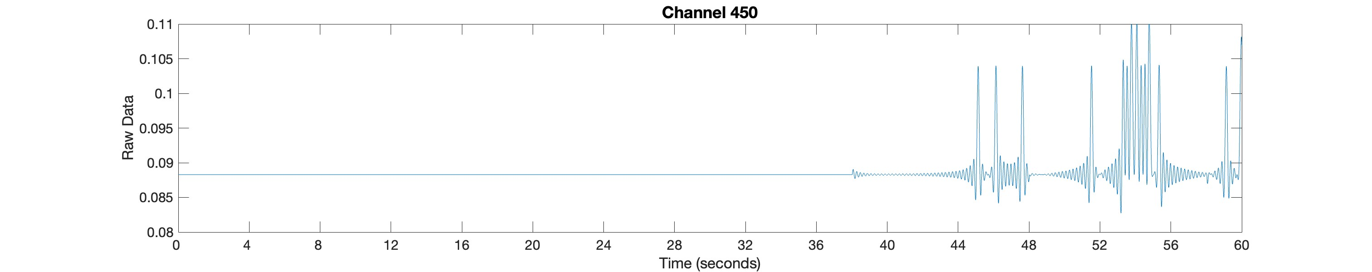
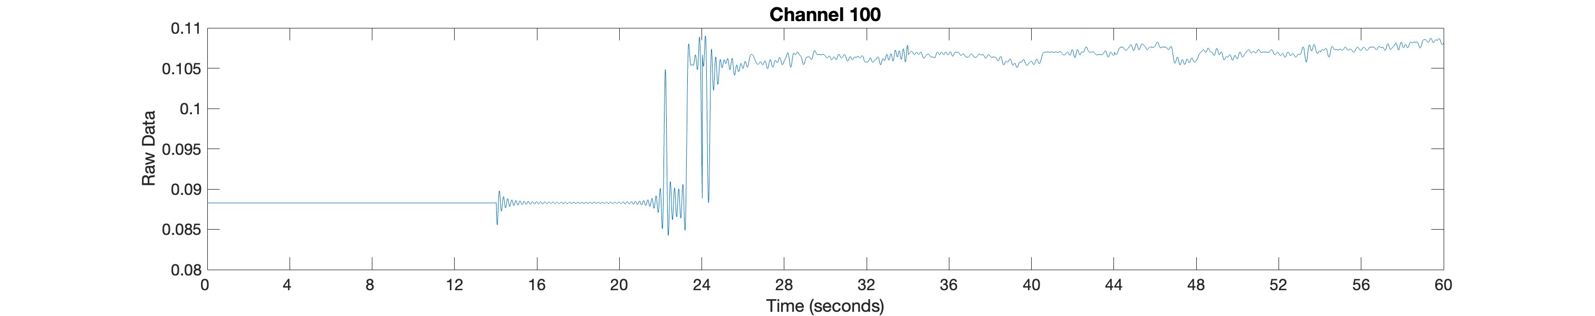
Data Analysis: Confidence Metrics
If part of the signal is stationary, it is unfeasible to retrieve information from it
Assert as confidence the percentage of the signal that is non-stationary
Notes:
OG: “find” instead of “discover”. ✅
Would be nice to show it also with graphs
Key point AS: the idea in this slide is to show the preliminary steps to asset which one could be not be considered as possible channel, we have 1056 and we are looking for the best ones so even exclude the one with just a small amount of information is not relevant
fare più slide e dividerle, riscrivere gli assi e metterli consistenti
inserie un refernce per l'intervallo 30%
- stationary rather than zero
- confidence typo there in amplitude

Slide 23
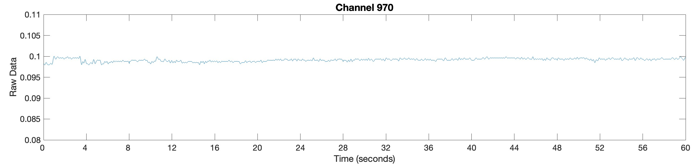
Data Analysis: Confidence Metrics
Exclude all the channels with noise signal
If part of the signal coming from that channel is not a noise signal assert as confidence percentage of the signal that is non-noisy
Notes:
Key point AS: the idea in this slide is to show the preliminary steps to asset which one could be not be considered as possible channel, we have 1056 and we are looking for the best ones so even exclude the one with just a small amount of information is not relevant
fare più slide e dividerle, riscrivere gli assi e metterli consistenti
inserie un refernce per l'intervallo 30%
- stationary rather than zero
- confidence typo there in amplitude

Slide 24
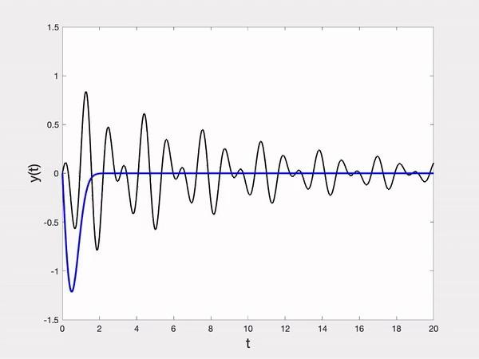
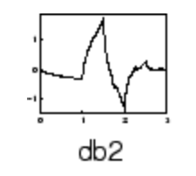
Data Analysis: Wavelet
Wavelet^{[1][2][3]}
Multiresolution analysis (MRA) of the maximal overlap discrete wavelet transform (MODWT)
Daubechies wavelet with two vanishing moment
[1] Sadek et al. « Nonintrusive Vital Signs Monitoring for Sleep Apnea Patients: A Preliminary Study » [2] Chen, Wenxi, et al. « Unconstrained monitoring of long-term heart and breath rates during sleep »
[3] M. Akay, « Wavelet applications in medicine »
Notes:
In other words, we pick a wavelet of a particular scale (like the blue wavelet in the gif above).
Then, we slide this wavelet across the entire signal i.e. vary its location, where at each time step we multiply the wavelet and signal.
The product of this multiplication gives us a coefficient for that wavelet scale at that time step. We then increase the wavelet scale (e.g. the red and green wavelets) and repeat the process.

Slide 25
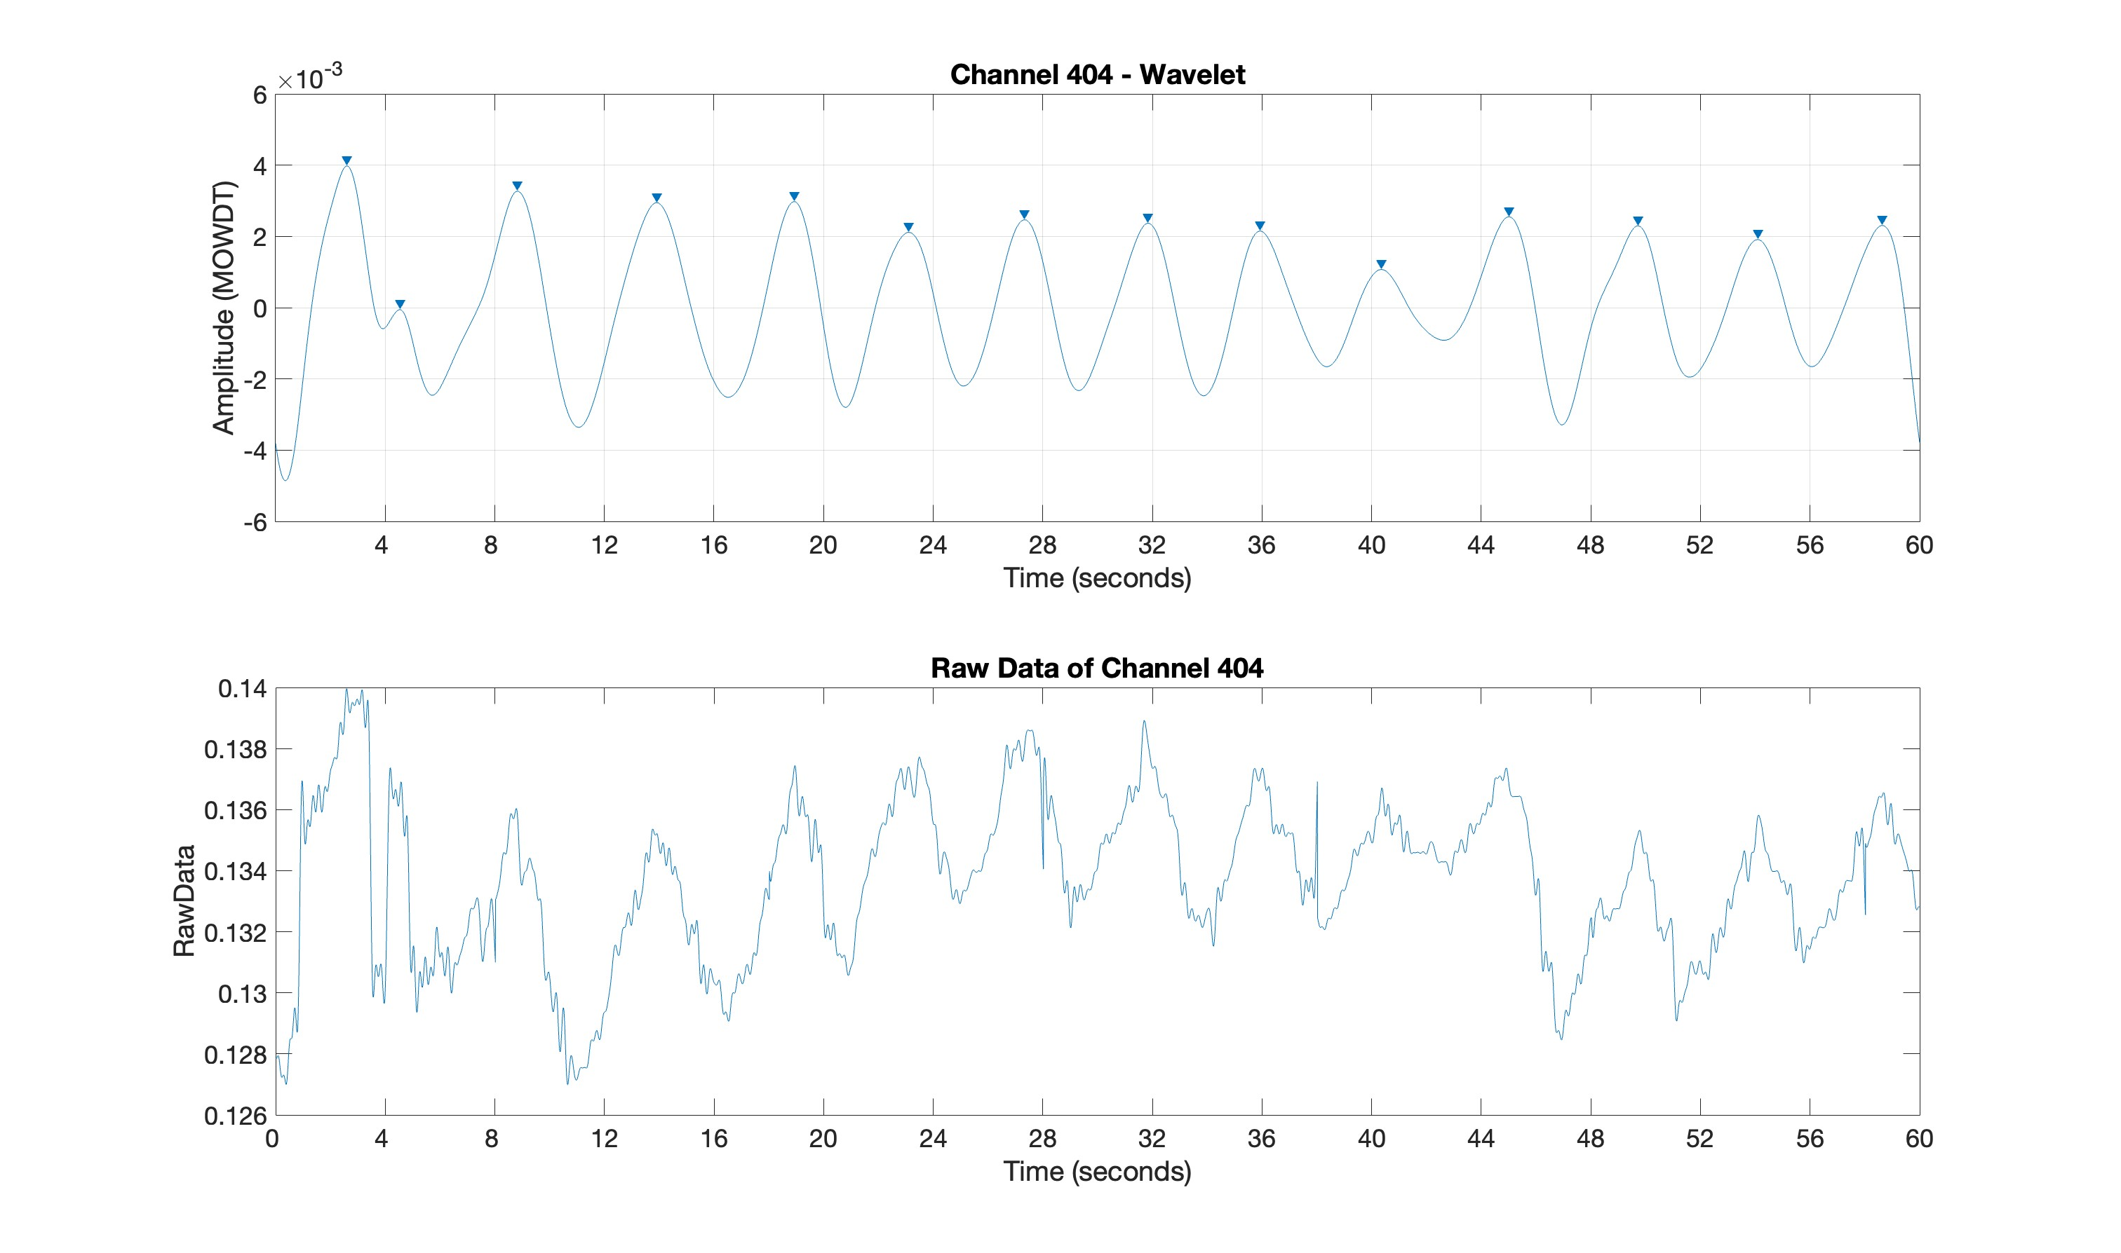
Data Analysis: Wavelet

Slide 26
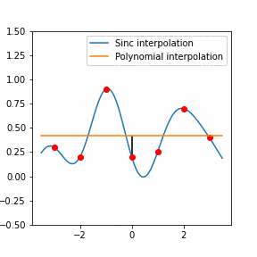
Data Analysis: Savitz-Golay filter
Savitz–Golay filter ^{[1][2]}
Savitzky-Golay smoothing filter
Polynomial order of 9
[1] Baker S, et al. « Determining respiratory rate from photoplethysmogram and electrocardiogram signals using respiratory quality indices and neural networks »
[2] Sadek, et al. « A new approach for detecting sleep apnea using a contactless bed sensor: comparison study »
Notes:
Key point (AS): Savitzky-Golay smoothing filters are typically used to "smooth out" a noisy signal whose frequency span (without noise) is large. They are also called digital smoothing polynomial filters or least-squares smoothing filters. The idea of Savitzky-Golay filters is simple – for each sample in the filtered sequence, take its direct neighborhood of N neighbors and fit a polynomial to it.
The Saviztky-Golay (S-G) filtering can be considered as a generalized moving average filter. It is a low pass filter whose structure is similar to a finite impulse response (FIR) filter. It is well suited for its signal smoothening operation, thereby increasing the signal-to-noise ratio without altering the signal. This is accomplished with a process called convolution, by placing a low degree polynomial in place of successive adjacent data points by the linear least squares method.

Slide 27
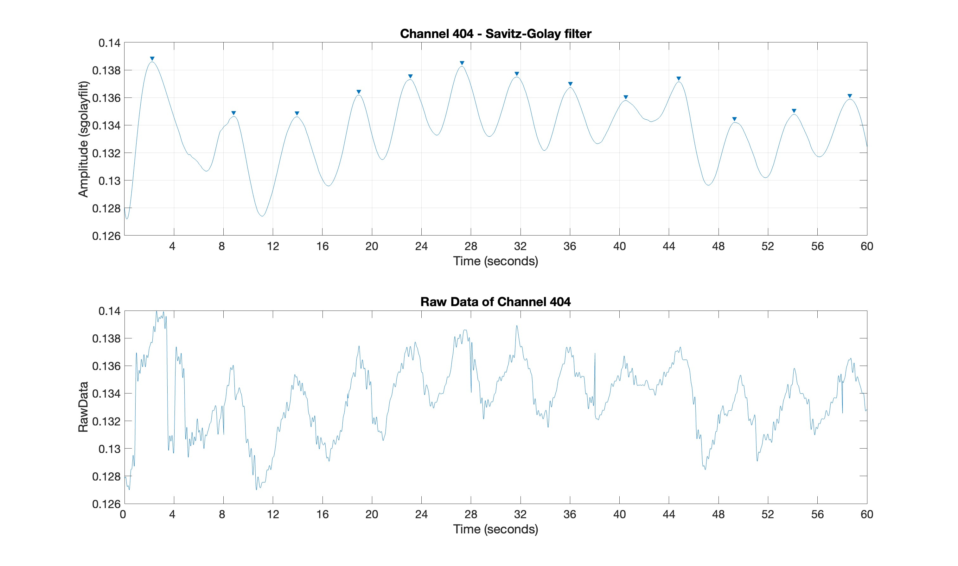
Data Analysis: Savitz-Golay filter

Slide 28
Confidence Metrics applied to filtered signal
Exclude the reconstructed signal if the respiratory rate per minute (rpm) is under 30^{[1]}
The Euclidean distance between the signal's valley and peaks should differ by up to ±20% from the preceding breath^{[2]}
[1] Yuan G. et al. «Respiratory rate and breathing pattern»
[2] Meredith D.J. et al. «Photoplethysmographic derivation of respiratory rate: a review of relevant physiology»
Notes:
To be inseret the plot , ,
it has to be enough to represent a breath
The breath at rest can arrive from 4bpm up to 30bpm in case of respiratory problem
A current breath has a similar amplitude with the previous and the following one

Slide 29
Confidence Metrics applied to filtered signal
The distance peaks and valley on the time axis should differ by up to ±20% from the previous breath^{[1]}
[1] Peter H. Charlton,, et al. «Waveform Analysis to Estimate Respiratory Rate»
Notes:
To be inseret the plot , ,
it has to be enough to represent a breath
The breath at rest can arrive from 4bpm up to 30bpm in case of respiratory problem
A current breath has a similar amplitude with the previous and the following one

Slide 30

Overview
Introduction
Methods
Data Analysis
Result
Conclusion

Slide 31
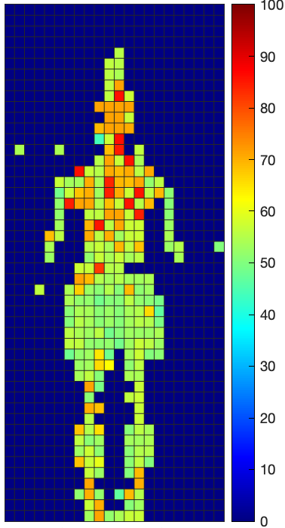
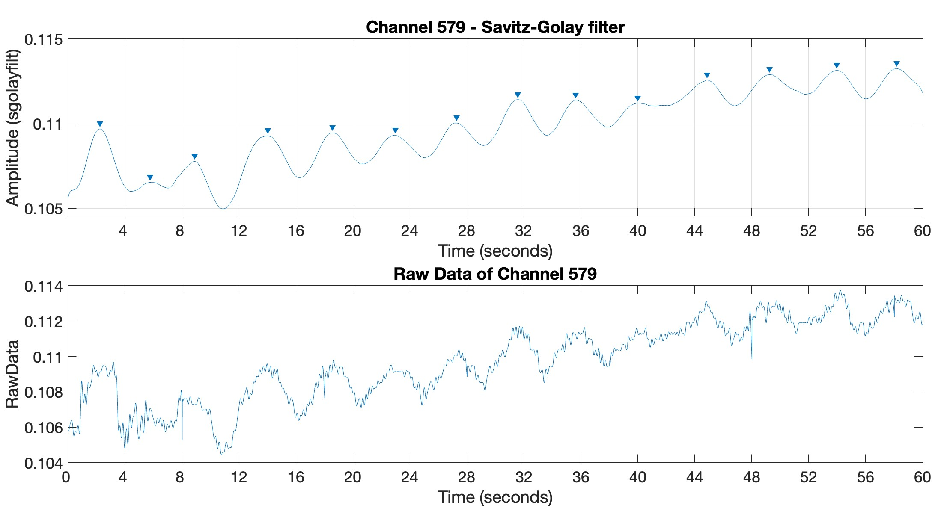
Result: Evaluation Metrics
Confidence Metrics
Notes:
Supine: sulla schiena
Prone: sulla pancia

Slide 32
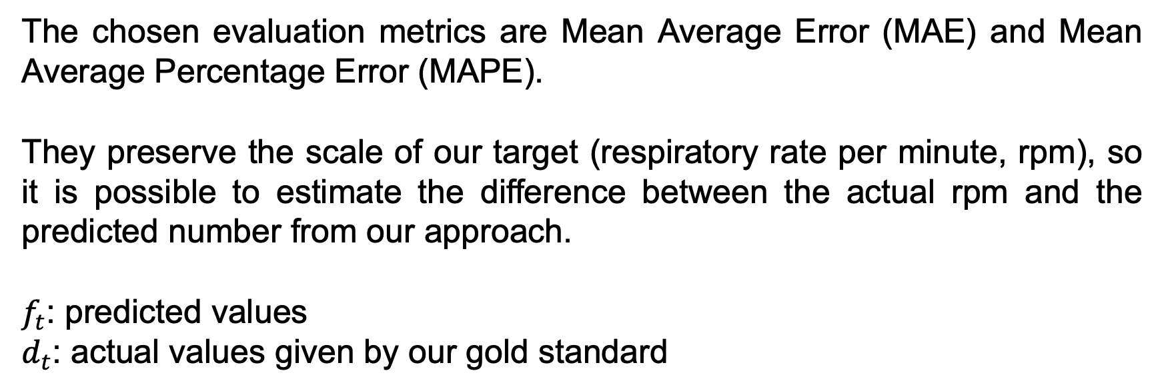
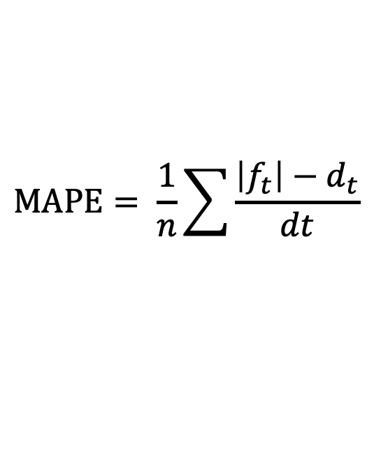
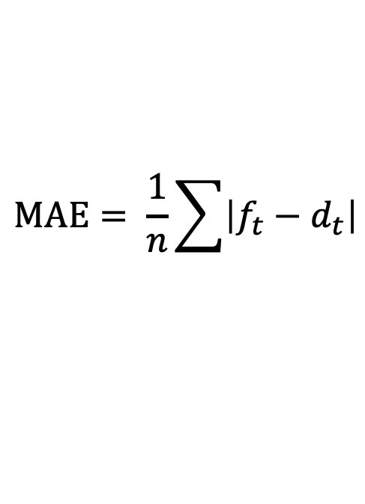
Result: Evaluation Metrics
The chosen evaluation metrics are Mean Average Error (MAE) and Mean Average Percentage Error (MAPE).
They preserve the scale of our target (respiratory rate per minute, rpm), so it is possible to estimate the difference between the actual rpm and the predicted number from our approach.
$f_{t}$: predicted values
$d_{t}$: actual values given by our gold standard
$$MAE= \frac{1}{n}\sum{\left|f_{t}−d_{t}\right|}$$
$$MAPE= \frac{1}{n}\sum{\frac{\left|f_{t}\right|−d_{t}}{dt}}$$
Notes:
Supine: sulla schiena
Prone: sulla pancia

Slide 33
Result: Stationary bed
Supine | Wavelet | Savitz-Golay
MAE (rpm) | 2.17 | 1.14
MAPE | 17.8% | 9.28%
Left | Wavelet | Savitz-Golay
MAE (rpm) | 2.45 | 1.36
MAPE | 24.6% | 11.6%
Prone | Wavelet | Savitz-Golay
MAE (rpm) | 4.21 | 3.35
MAPE | 39.9% | 31.9%
Right | Wavelet | Savitz-Golay
MAE (rpm) | 2.46 | 1.82
MAPE | 19.9% | 14.9%
Notes:
Supine: sulla schiena
Prone: sulla pancia

Slide 34
Result: Somnomat
Supine | Wavelet | Savitz-Golay
MAE (rpm) | 3.02 | 1.82
MAPE | 25.7% | 15.6%
Left | Wavelet | Savitz-Golay
MAE (rpm) | 2.45 | 1.42
MAPE | 19.9% | 11.7%
Prone | Wavelet | Savitz-Golay
MAE (rpm) | 3.23 | 1.98
MAPE | 28.6% | 17.9%
Right | Wavelet | Savitz-Golay
MAE (rpm) | 2.94 | 2.24
MAPE | 24.4% | 18.5%
Notes:
Supine: sulla schiena
Prone: sulla pancia

Slide 35
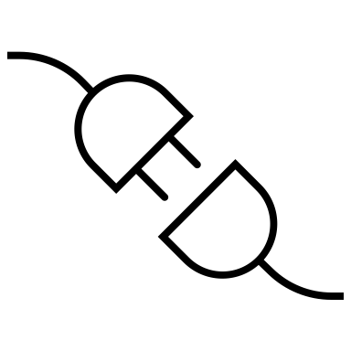
Overview
Introduction
Methods
Data Analysis
Result
Conclusion

Slide 36
Conclusion and Future Research
The estimation of the respiratory rate of a person can be retrieved using our mattress
Savitz-Golay filter has the Mean Average Percentage Error (MAPE) that we fixed as the goal (less than 20%)
The confidence metrics that we have defined were useful to find the best channels in the mattress
The mat can be used with the moving bed without interference
As future development, more participants should be involved in the data collection

Slide 37
Prof. Robert Riener
robert.riener@hest.ethz.ch
Prof. Domenico Sorrenti
domenico.sorrenti@unimib.it
Prof. Cristiano Alessandro
cristiano.alessandro@unimib.it
Alexander Breuss
alexander.breuss@hest.ethz.ch
Oriella Gnarra
oriella.gnarra@hest.ethz.ch
Manuel Fujs
manuel.fujs@hest.ethz.ch

Slide 38
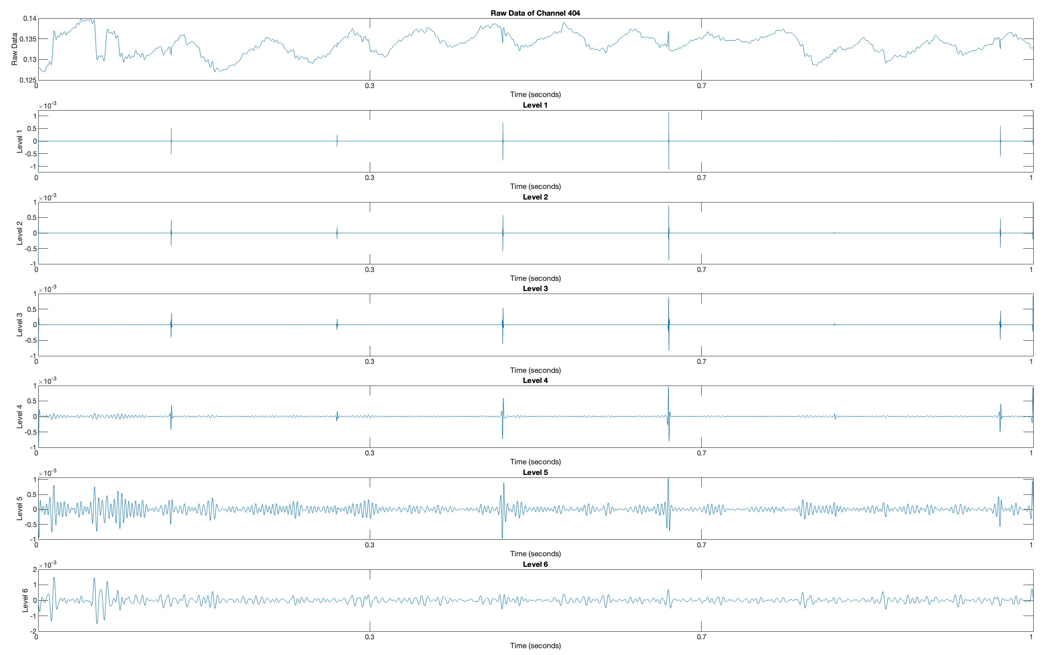

Slide 39
